Slide 1

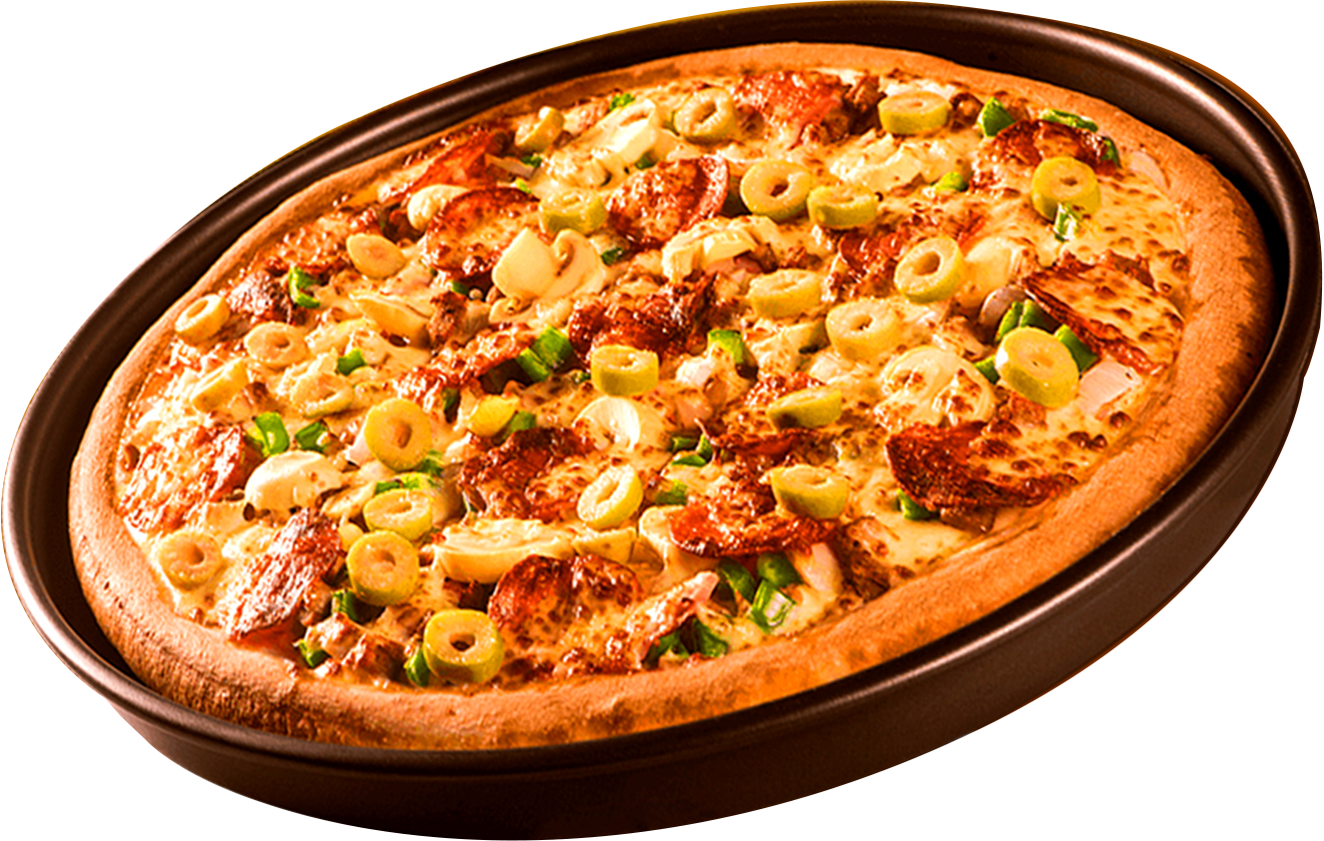


PIZZA
SALES
ANALYSIS
SURYAKANT RANJAN

Slide 2

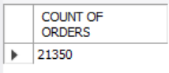
1) Retrieve the total number of orders placed.
QUERY :-
OUTPUT :-

Slide 3
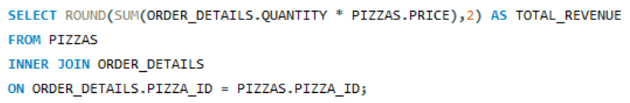
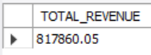
2) Calculate the total revenue generated from pizza sales.
QUERY :-
OUTPUT :-

Slide 4
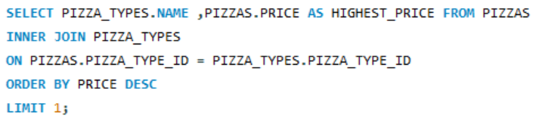
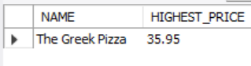
3) Identify the highest priced pizza.
QUERY :-
OUTPUT :-

Slide 5
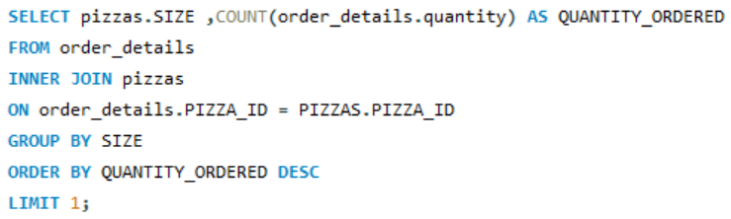
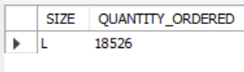
4) Identify the most common pizza size ordered.
QUERY :-
OUTPUT :-

Slide 6
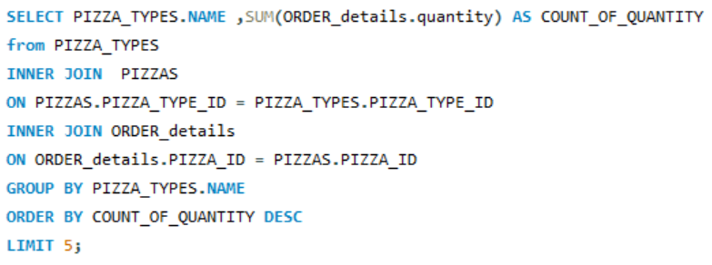
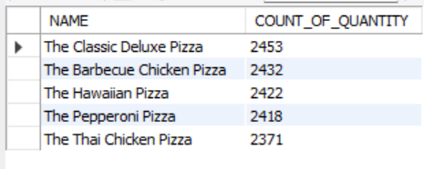
5) List the top 5 most ordered pizza types along with their quantities.
QUERY :-
OUTPUT :-

Slide 7
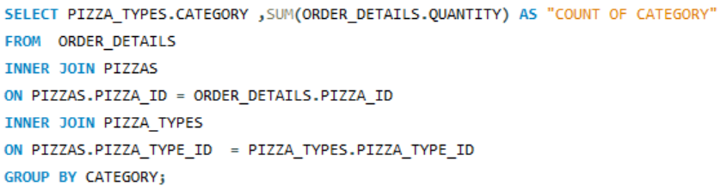
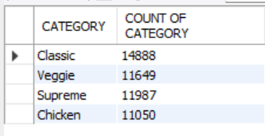
6) Join the necessary tables to find the total quantity of each pizza category ordered.
QUERY :-
OUTPUT :-

Slide 8
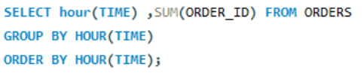
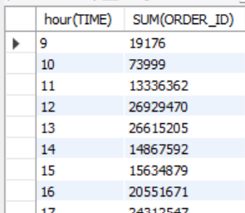
7) Determine the distribution of orders by hour of the day.
QUERY :-
OUTPUT :-

Slide 9
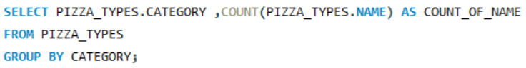
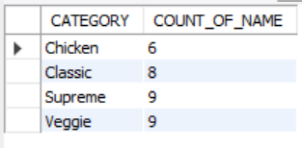
8) find the category-wise distribution of pizzas.
QUERY :-
OUTPUT :-

Slide 10
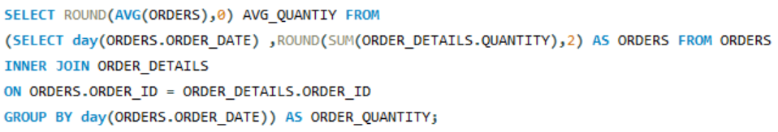
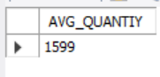
9) Group the orders by date and calculate the average number of pizzas ordered per day.
QUERY :-
OUTPUT :-

Slide 11
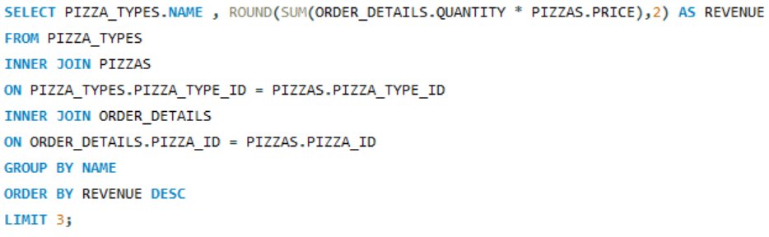
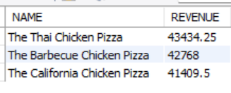
10) Determine the top 3 most ordered pizza types based on revenue.
QUERY :-
OUTPUT :-

Slide 12
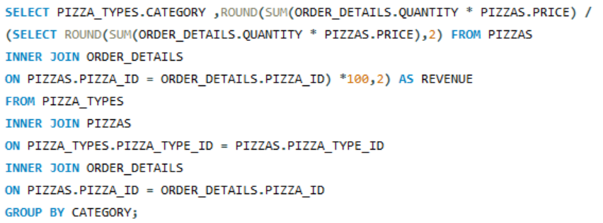
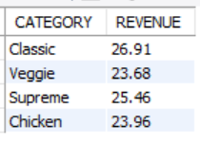
11) Calculate the percentage contribution of each pizza type to total revenue.
QUERY :-
OUTPUT :-

Slide 13
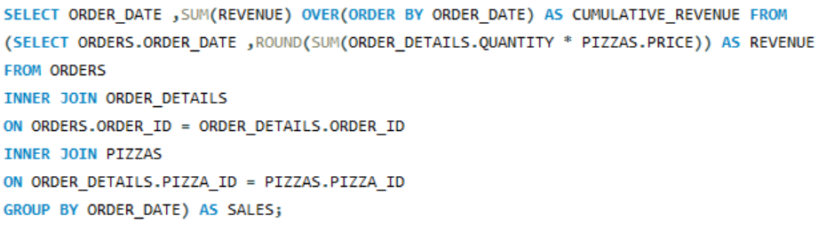
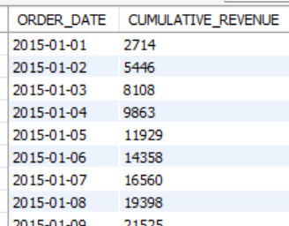
12) Analyze the cumulative revenue generated over time.
QUERY :-
OUTPUT :-

Slide 14
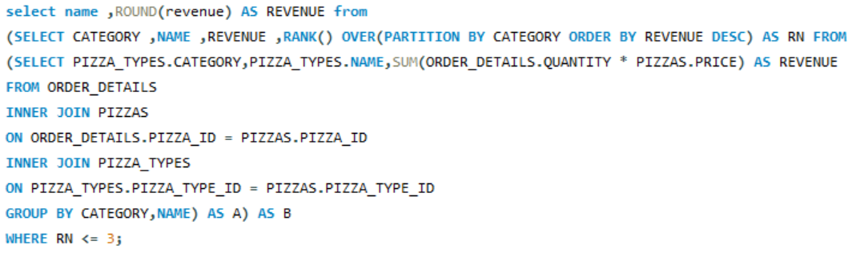
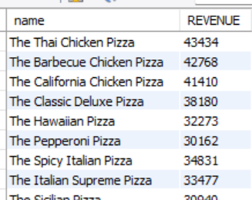
13) Determine the top 3 most ordered pizza types based on revenue for each pizza category.
QUERY :-
OUTPUT :-

Slide 15
Thank you
SURYAKANT RANJAN

